Slide 2
– Hardware and Data:
In this update, your hardware bill of materials must be finalized (Brian).
You should also have all purchase orders submitted, and ideally have the hardware in-hand (??) .
You should also have a list of data types you will collect (e.g. temperature, GPS coordinates, water flow, voltage), and how you will acquire this data (e.g. sensors, Google Maps API) (Garima).
-Background on our problem and why air quality is important (John_

Slide 3
Deliverables assignments
Criteria to research - healthy limits based on health conditions - metrics for assessing indoor air quality - think of recommendations - effect of different actions and actuation on PM, CO2 and Temp Hardware to build - test bed - CO2 sensor, - Wooden box - AutoCAD or pdf to svg, with ports scaled for the air input - Potential weatherstripping for outdoor use - easily bought weatherstripping -

Slide 5









Datapath
Ambient pollution data sent to cloud and then to stakeholders
CO₂
VOC
PM
Motivation
Mapping
Implementation
Review

Slide 6



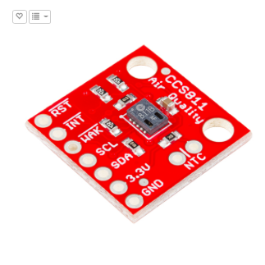
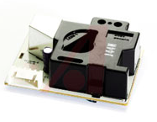
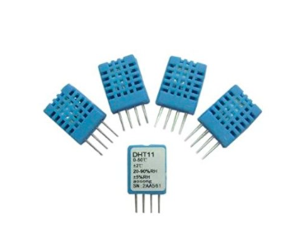
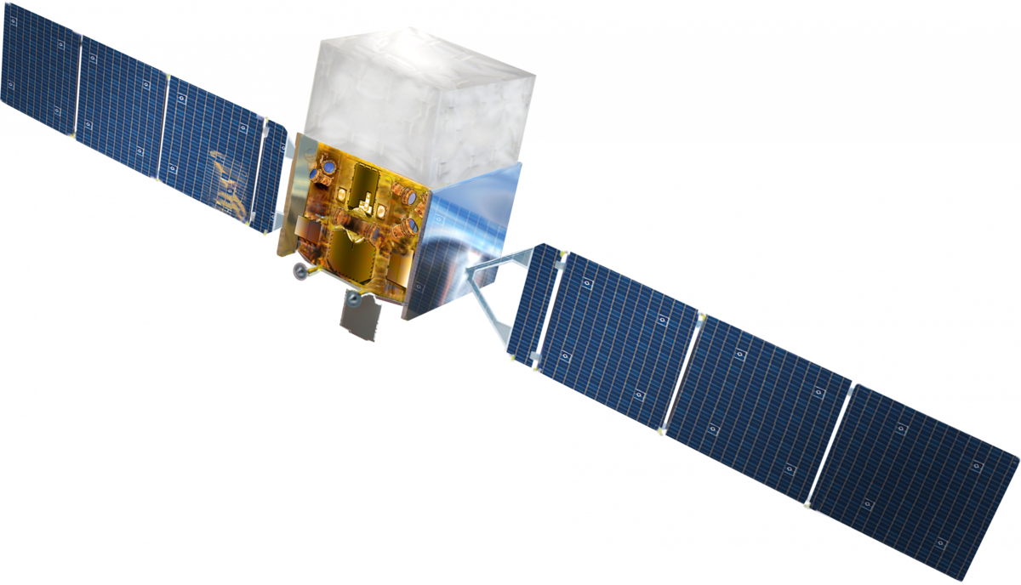
Data Acquisition
Pollution and ambient data collected using low-cost sensors
VOC
CO₂
PM
%
SparkFun Air Quality Sensor
Breakout Model # CCS811
Amphenol Advanced Sensors SM-PWM-01C
Geeetech 4PCS DHT11 Digital Humidity Temperature Sensor
In-Built Geoloc
& Satellite Data
CE 186: Bill of Materials
Motivation
Mapping
Implementation
Review

